Slide 1
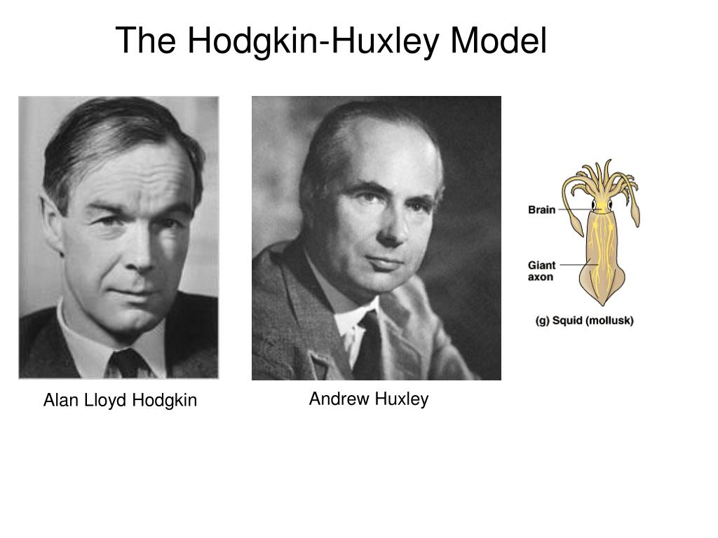
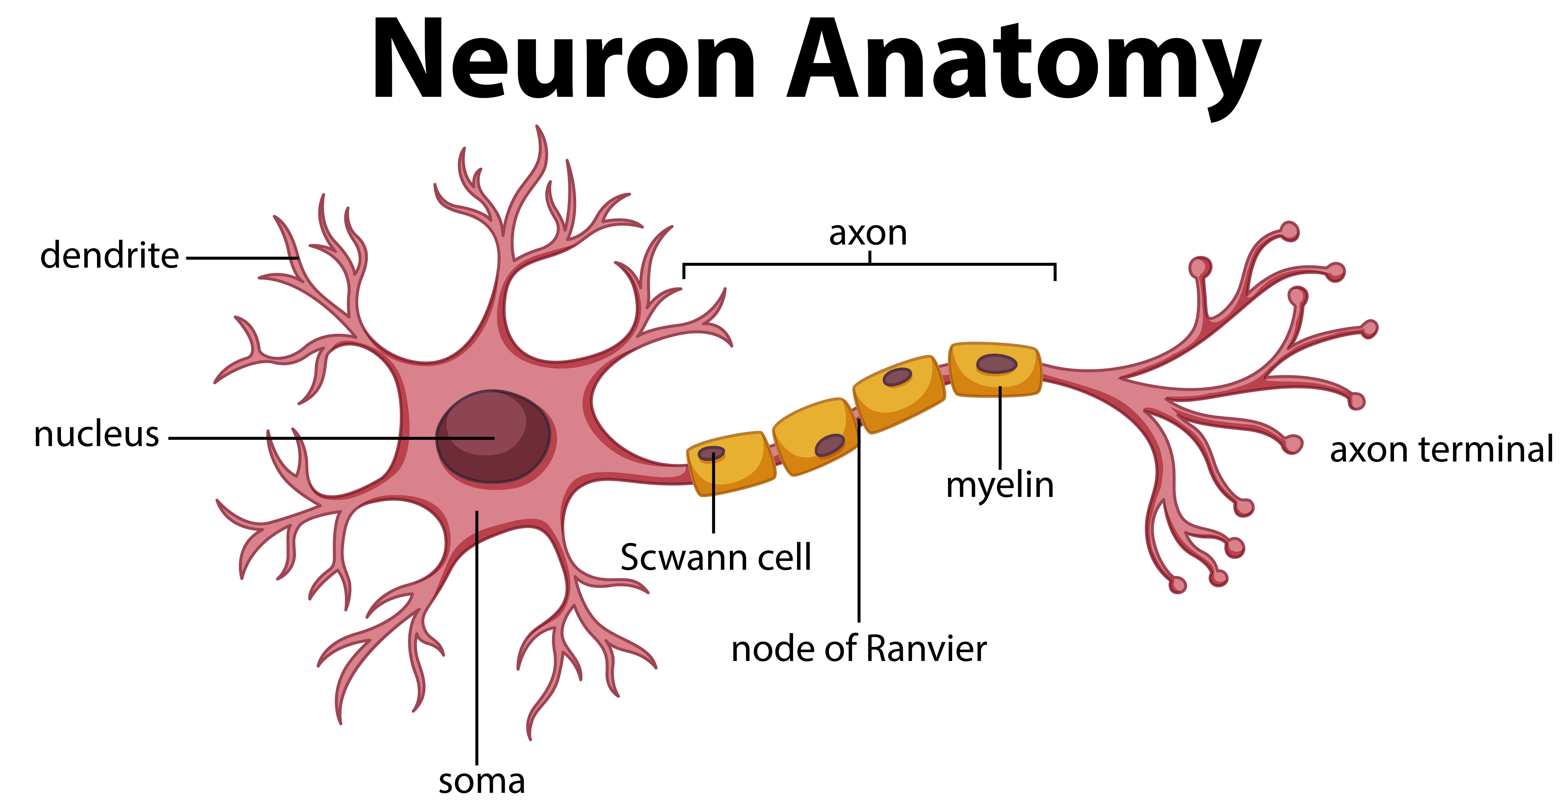
Numerical Approximations of the Hodgkin–Huxley Model
Miya Spinella

Slide 2
Overview
History of the Hodgkin-Huxley Model
Background information about neurons and action potentials
Equations in the Hodgkin-Huxley Model
Numerical Analysis of the
Hodgkin-Huxley Model

Slide 3
History of Hodgkin-Huxley Model
Describes the process of an action potential
Created by Alan Lloyd Hodgkin and Andrew Huxley with research about modelling the action potentials through the squid giant axon
Awarded Nobel Prize in 1963

Slide 4
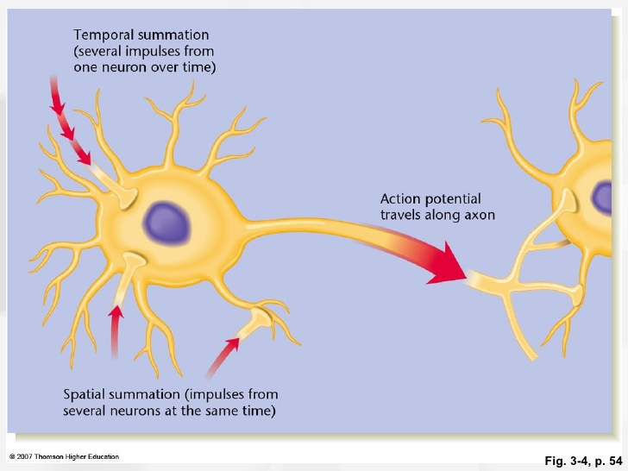
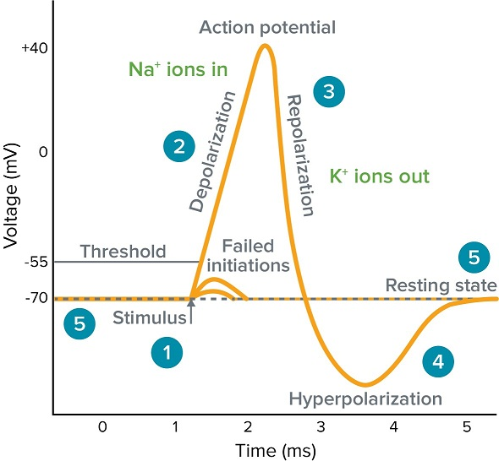
Action Potentials

Slide 5
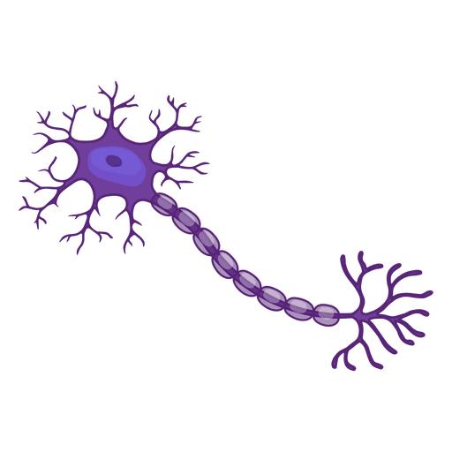


Action Potentials: Definition
Explosion of depolarizing current moving across a cell
Send impulses or signals to other cells to relay information
Occurs in excitable cells

Slide 6
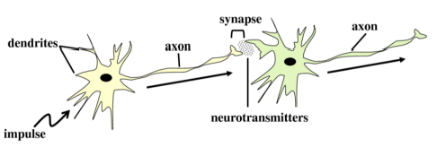
Neuron Anatomy
Signal Received!

Slide 7
Neuron Anatomy
Signal Travels!

Slide 8
Neuron Anatomy
Action Potential Begins!

Slide 9
Neuron Anatomy
Cycle Continues!

Slide 10
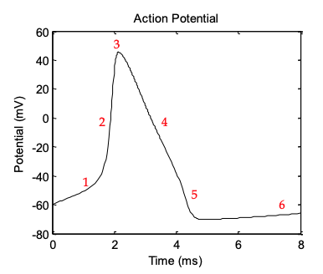
Voltage of Action Potential
Voltage increases until firing potential reached
Firing Potential
Resting Potential (-65mV)
Failed Initiations

Slide 11
Voltage of Action Potential
Depolarization Phase
Sodium channels open
Sodium (Na+) enters cell
Cell becomes more positive
Firing Potential
Resting Potential (-65mV)

Slide 12
Voltage of Action Potential
Sodium channels close
Maximum voltage reached
Firing Potential
Resting Potential (-65mV)

Slide 13
Voltage of Action Potential
Repolarization Phase
Potassium channels open
Potassium (K+) exits cell
Voltage decreases
Firing Potential
Resting Potential (-65mV)

Slide 14
Voltage of Action Potential
Hyperpolarization Phase
Potassium channels close
Voltage decreases below resting potential
Firing Potential
Resting Potential (-65mV)

Slide 15
Voltage of Action Potential
Voltage slightly increases
Voltage returns to resting potential
Firing Potential
Resting Potential (-65mV)

Slide 16
Other Action Potential Facts
Action potentials are always the same size
Membrane has increased conductivity during action potential
K+
Na+
K+
Na+
K+
Na+

Slide 17
Hodgkin-Huxley Model

Slide 18
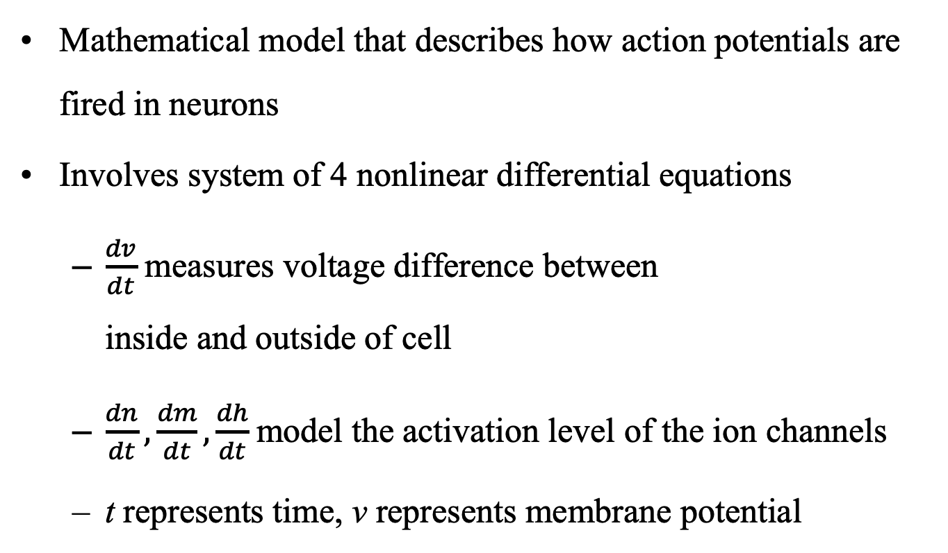
Purpose and Definition
Mathematical model that describes how action potentials are fired in neurons
Involves system of 4 nonlinear differential equations
  $\frac{dv}{dt}$ measures voltage difference between
  inside and outside of cell
  $\frac{dn}{dt},\frac{dm}{dt},\frac{dh}{dt}$model the activation level of the ion channels
  t represents time, v represents membrane potential

Slide 19
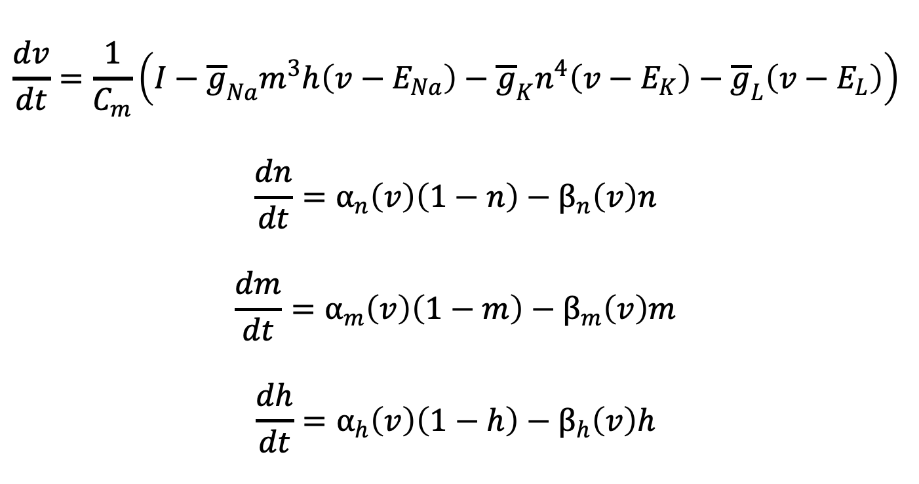
Model Equations
$$\frac{dv}{dt}=\frac{1}{C_{m}}\left(I−{\overline{g}}_{Na}m^{3}h\left(v−E_{Na}\right)−{\overline{g}}_{K}n^{4}\left(v−E_{K}\right)−{\overline{g}}_{L}\left(v−E_{L}\right)\right)$$
$$\frac{dn}{dt}=α_{n}\left(v\right)\left(1−n\right)−β_{n}\left(v\right)n$$
$$\frac{dm}{dt}=α_{m}\left(v\right)\left(1−m\right)−β_{m}\left(v\right)m$$
$$\frac{dh}{dt}=α_{h}\left(v\right)\left(1−h\right)−β_{h}\left(v\right)h$$
6 different supporting functions
11 different constants

Slide 20
Ion Channel Constants
n, m, h
Dimensionless quantities between 0 and 1 associated with potassium channel activation, sodium channel activation, and sodium channel inactivation, respectively.
Defines gates for specific channel
    eg. Sodium channel has 3 m gates and 1 h gate

Slide 21
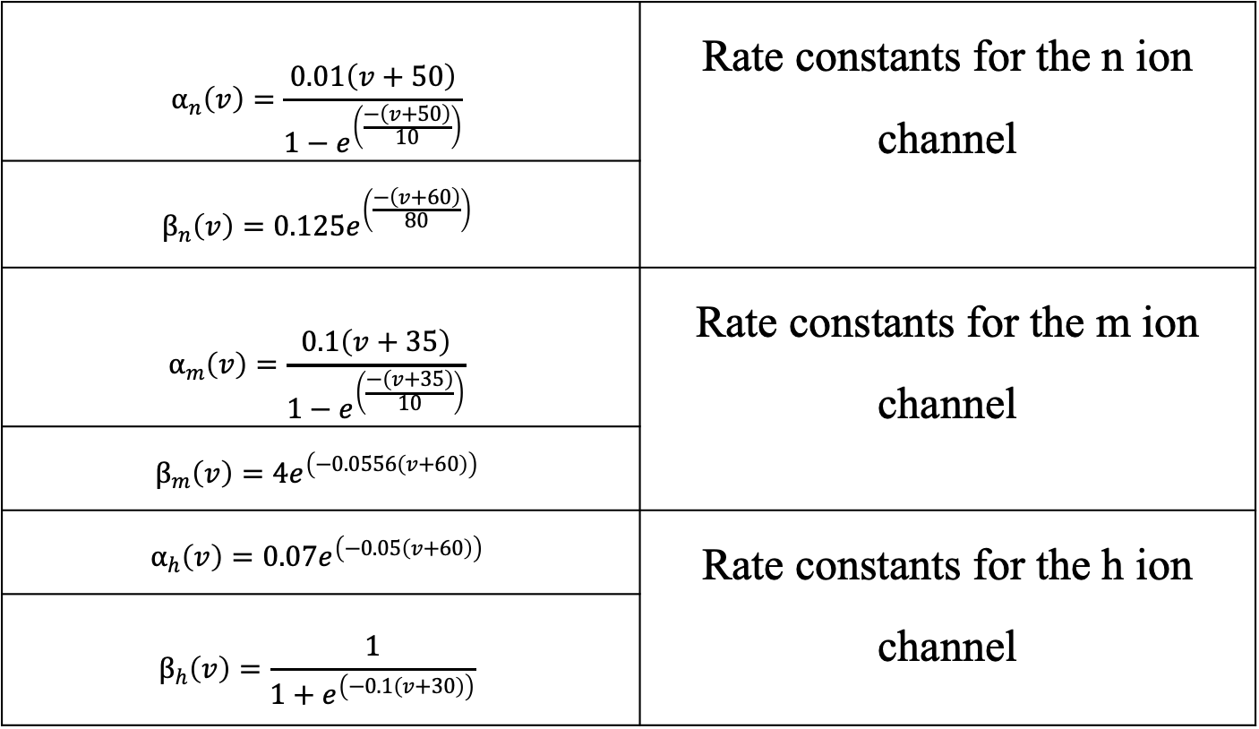
Supporting Functions
$$α_{n}\left(v\right)=\frac{0.01\left(v+50\right)}{1−e^{\left(\frac{−\left(v+50\right)}{10}\right)}}$$ | Rate constants for the n ion channel
$$β_{n}\left(v\right)=0.125e^{\left(\frac{−\left(v+60\right)}{80}\right)}$$ | One of the rate constants of the n ion channel
$$α_{m}\left(v\right)=\frac{0.1\left(v+35\right)}{1−e^{\left(\frac{−\left(v+35\right)}{10}\right)}}$$ | Rate constants for the m ion channel
$$β_{m}\left(v\right)=4e^{\left(−0.0556\left(v+60\right)\right)}$$ | One of the rate constants of the m ion channel
$$α_{h}\left(v\right)=0.07e^{\left(−0.05\left(v+60\right)\right)}$$ | Rate constants for the h ion channel
$$β_{h}\left(v\right)=\frac{1}{1+e^{\left(−0.1\left(v+30\right)\right)}}$$ | One of the rate constants of the h ion channel

Slide 22
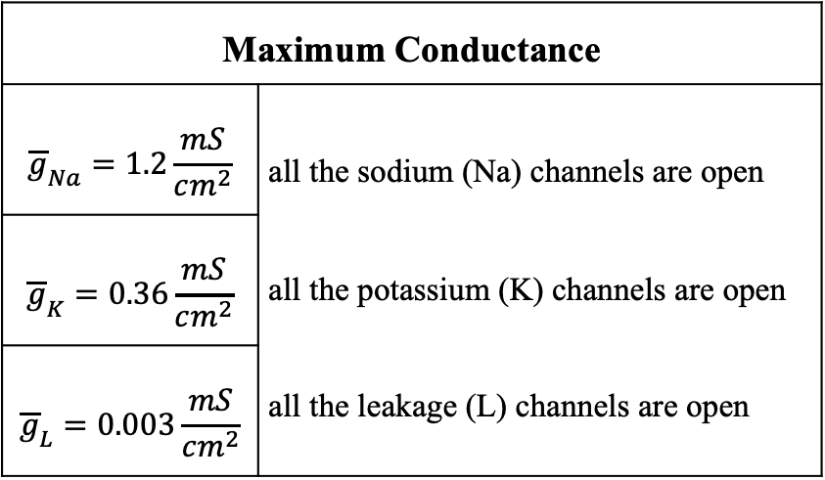
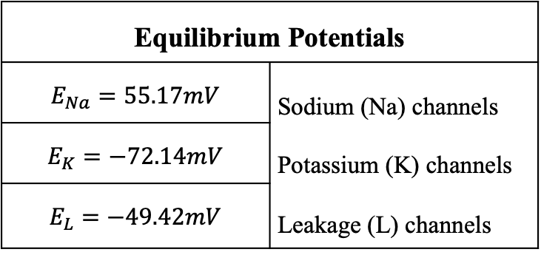
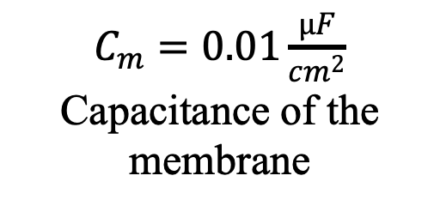
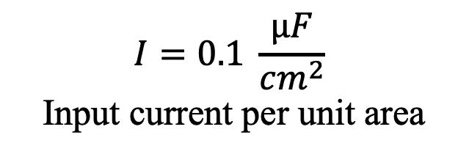
Constants
Equilibrium Potentials
$$E_{Na}=55.17mV$$ | Sodium (Na) channels Potassium (K) channels Leakage (L) channels
$$E_{K}=−72.14mV$$ | Equilibrium potential of the potassium (K) channels
$$E_{L}=−49.42mV$$ | Equilibrium potential of the leakage (L) channels
$$I=0.1 \frac{μF}{cm^{2}}$$
Input current per unit area
Maximum Conductance
$${\overline{g}}_{Na}=1.2\frac{mS}{cm^{2}}$$ | all the sodium (Na) channels are open all the potassium (K) channels are open all the leakage (L) channels are open
$${\overline{g}}_{K}=0.36\frac{mS}{cm^{2}}$$ | Maximum conductance measured when all the potassium (K) channels are open
$${\overline{g}}_{L}=0.003\frac{mS}{cm^{2}}$$ | Maximum conductance measured when all the leakage (L) channels are open
$C_{m}=0.01\frac{μF}{cm^{2}}$
Capacitance of the membrane

Slide 23
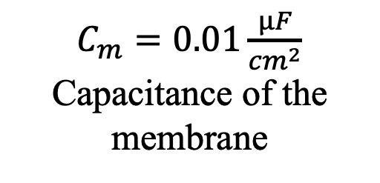
Capacitance
Capacitance - “Ratio of the amount of electric charge stored on a conductor to a difference in electric potential”
Axon membrane imagined as long thin cylindrical capacitor
$C_{m}=0.01\frac{μF}{cm^{2}}$
Capacitance of the membrane
Axon

Slide 24
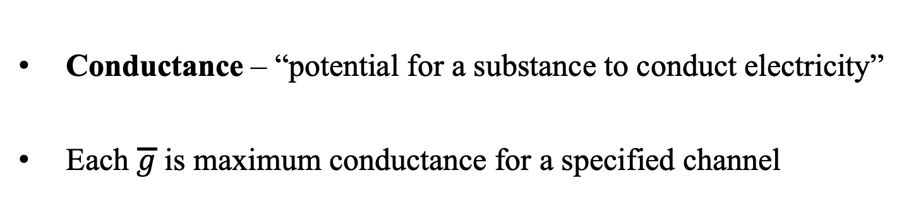
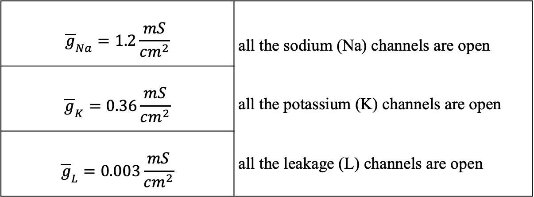
Maximum Conductance
Conductance – “potential for a substance to conduct electricity”
Each $\overline{g}$ is maximum conductance for a specified channel
$${\overline{g}}_{Na}=1.2\frac{mS}{cm^{2}}$$ | all the sodium (Na) channels are open all the potassium (K) channels are open all the leakage (L) channels are open
$${\overline{g}}_{K}=0.36\frac{mS}{cm^{2}}$$ | Maximum conductance measured when all the potassium (K) channels are open
$${\overline{g}}_{L}=0.003\frac{mS}{cm^{2}}$$ | Maximum conductance measured when all the leakage (L) channels are open

Slide 25
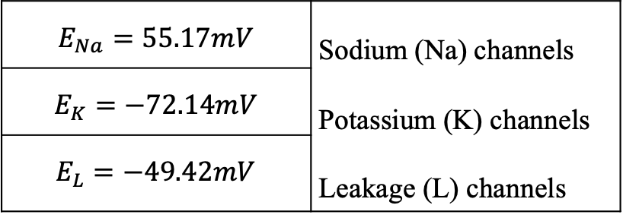
Equilibrium Potential
Each E is equilibrium potential, or reversal potential, for a specified channel
Equal to the voltage value required to form the boundary between the currents flowing inward and outward of cell
$$E_{Na}=55.17mV$$ | Sodium (Na) channels Potassium (K) channels Leakage (L) channels
$$E_{K}=−72.14mV$$ | Equilibrium potential of the potassium (K) channels
$$E_{L}=−49.42mV$$ | Equilibrium potential of the leakage (L) channels

Slide 26

Numerical Methods

Slide 27
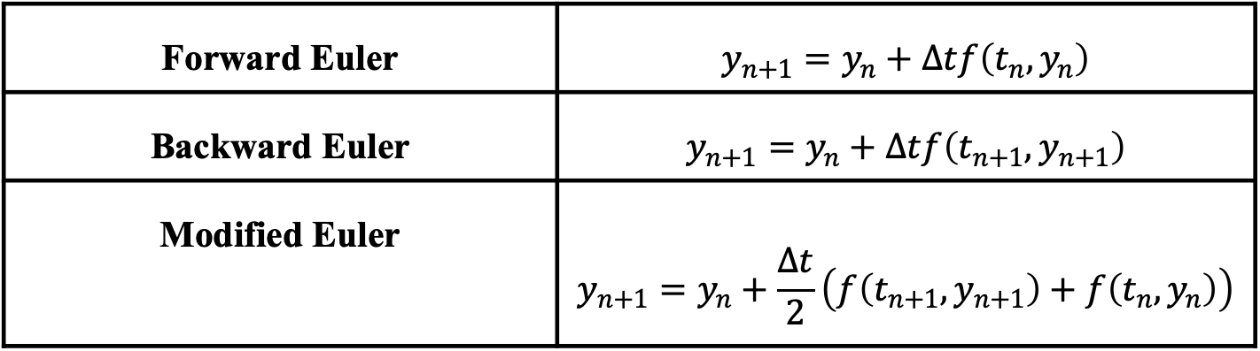
Euler’s Methods
Forward Euler | $$y_{n+1}=y_{n}+Δtf\left(t_{n},y_{n}\right)$$
Backward Euler | $$y_{n+1}=y_{n}+Δtf\left(t_{n+1},y_{n+1}\right)$$
Modified Euler | $$y_{n+1}=y_{n}+\frac{Δt}{2}\left(f\left(t_{n+1},y_{n+1}\right)+f\left(t_{n},y_{n}\right)\right)$$
Simplest methods and involve little computational time
However, some of the most unstable and inaccurate methods
  More iterations needed compared to other methods to achieve the same error

Slide 28
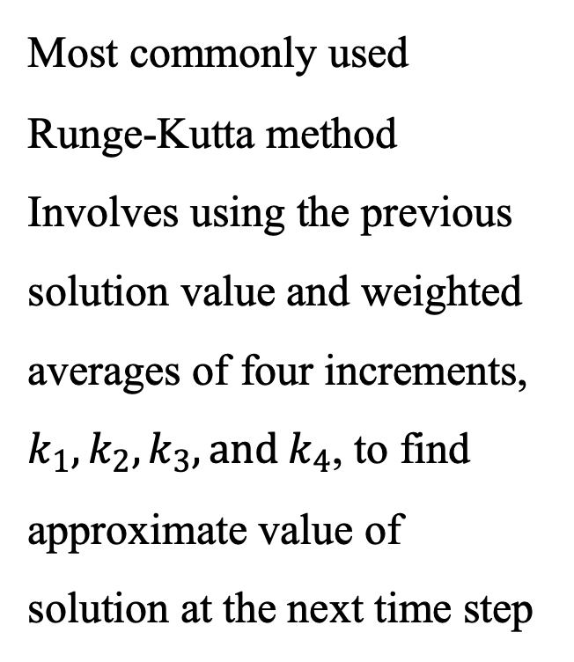
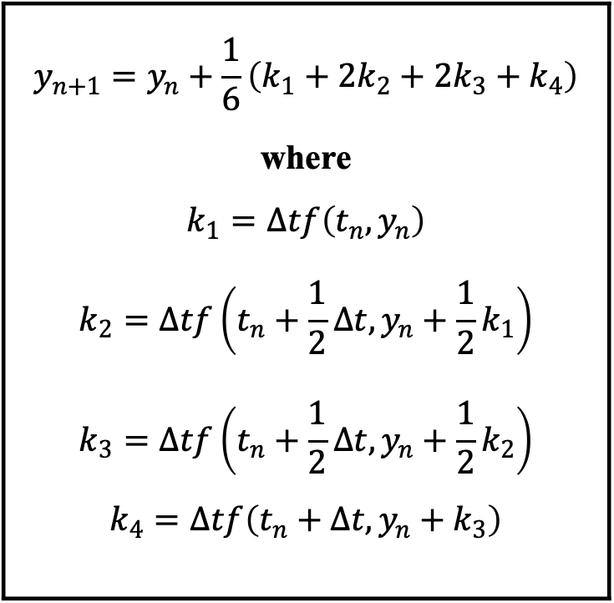
4th Order Runge-Kutta (RK4)
$$y_{n+1}=y_{n}+\frac{1}{6}\left(k_{1}+2k_{2}+2k_{3}+k_{4}\right)$$ where $$k_{1}=Δtf\left(t_{n},y_{n}\right)$$ $$k_{2}=Δtf\left(t_{n}+\frac{1}{2}Δt,y_{n}+\frac{1}{2}k_{1}\right)$$ $$k_{3}=Δtf\left(t_{n}+\frac{1}{2}Δt,y_{n}+\frac{1}{2}k_{2}\right)$$ $$k_{4}=Δtf\left(t_{n}+Δt,y_{n}+k_{3}\right)$$
Most commonly used
Runge-Kutta method
Involves using the previous solution value and weighted averages of four increments, $k_{1},k_{2},k_{3}, {and k}_{4}$, to find approximate value of solution at the next time step

Slide 29
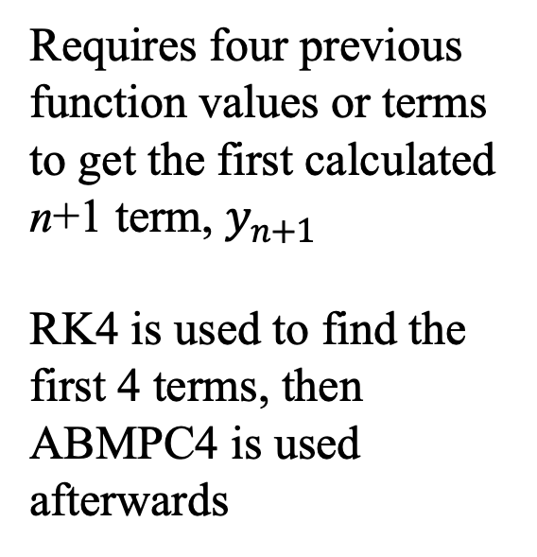
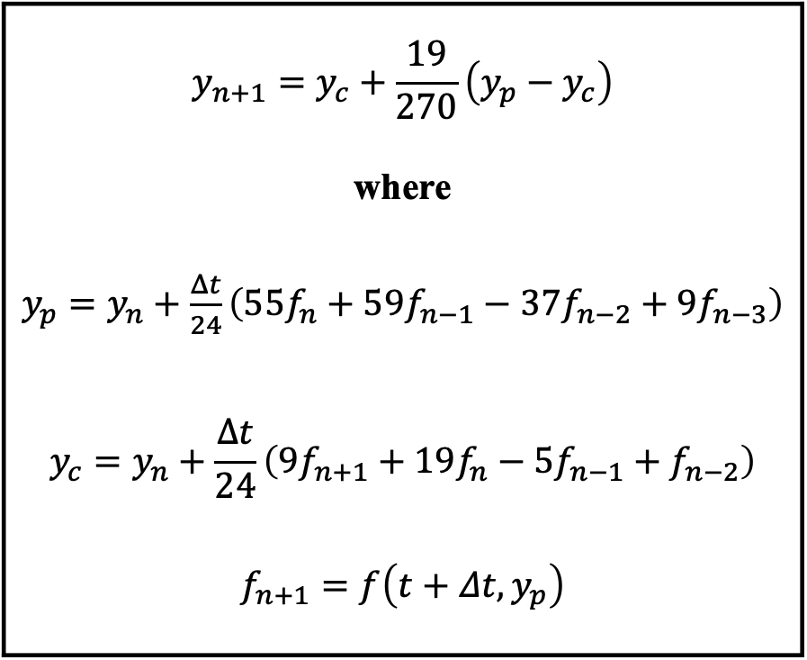
Adams-Bashforth-Moulton 4th Order Predictor-Corrector (ABMPC4)
$$y_{n+1}=y_{c}+\frac{19}{270}\left(y_{p}−y_{c}\right)$$ where $y_{p}=y_{n}+\frac{Δt}{24}\left(55f_{n}+59f_{n−1}−37f_{n−2}+9f_{n−3}\right)$ $$y_{c}=y_{n}+\frac{Δt}{24}\left(9f_{n+1}+19f_{n}−5f_{n−1}+f_{n−2}\right)$$ $$f_{n+1}=f\left(t+Δt, y_{p}\right)$$
Requires four previous function values or terms to get the first calculated n+1 term, $y_{n+1}$
RK4 is used to find the first 4 terms, then ABMPC4 is used afterwards

Slide 30
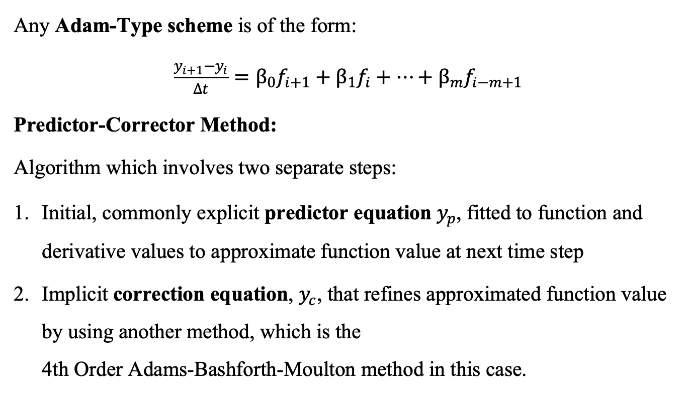
Background for ABMPC4
Any Adam-Type scheme is of the form:
$\frac{y_{i+1}−y_{i}}{Δt}=β_{0}f_{i+1}+β_{1}f_{i}+…+β_{m}f_{i−m+1}$
Predictor-Corrector Method:
Algorithm which involves two separate steps:
Initial, commonly explicit predictor equation $y_{p}$, fitted to function and derivative values to approximate function value at next time step
Implicit correction equation, $y_{c}$, that refines approximated function value by using another method, which is the
4th Order Adams-Bashforth-Moulton method in this case.

Slide 31
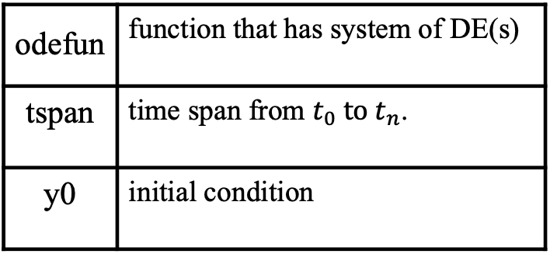
ODE45
Built-in Matlab function that solves systems of DE
Utilizes Runge-Kutta method and a variable time step for efficiency
[t, y] = ode45(odefun, tspan, y0)
Inputs
Outputs
odefun | function that has system of DE(s)
tspan | time span from $t_{0} to t_{n}$.
y0 | initial condition
t | column vector with time steps
y | array with the solution values for each time step

Slide 32
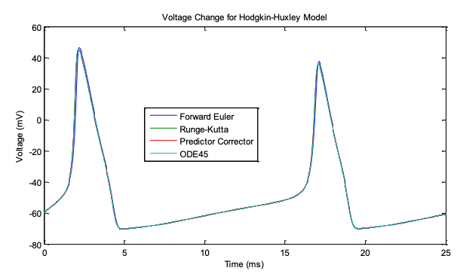
Numerical Analysis

Slide 33
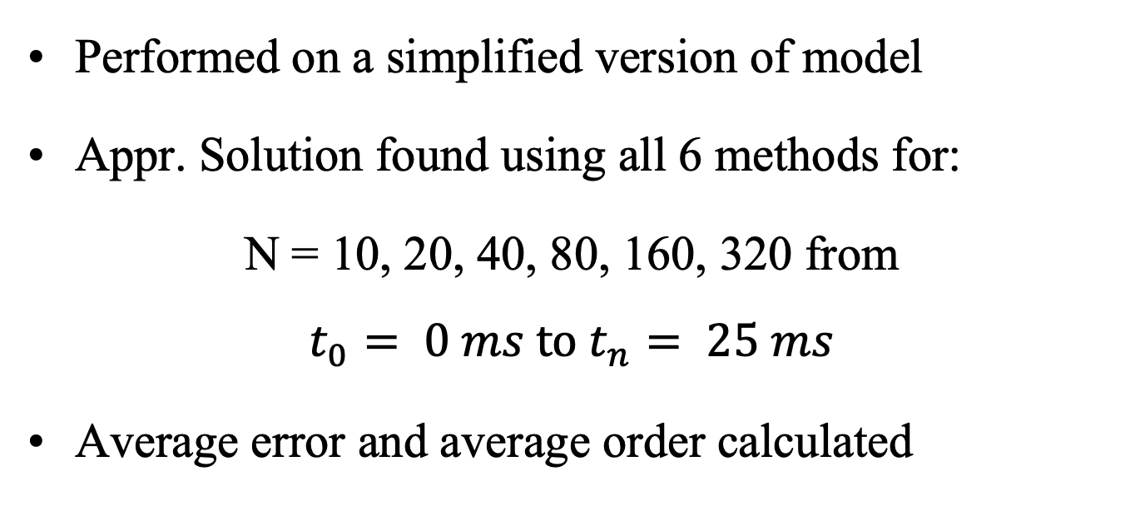
Numerical Analysis Overview
Performed on a simplified version of model
Appr. Solution found using all 6 methods for:
N = 10, 20, 40, 80, 160, 320 from
$$t_{0}= 0 ms to t_{n}= 25 ms$$
Average error and average order calculated

Slide 34
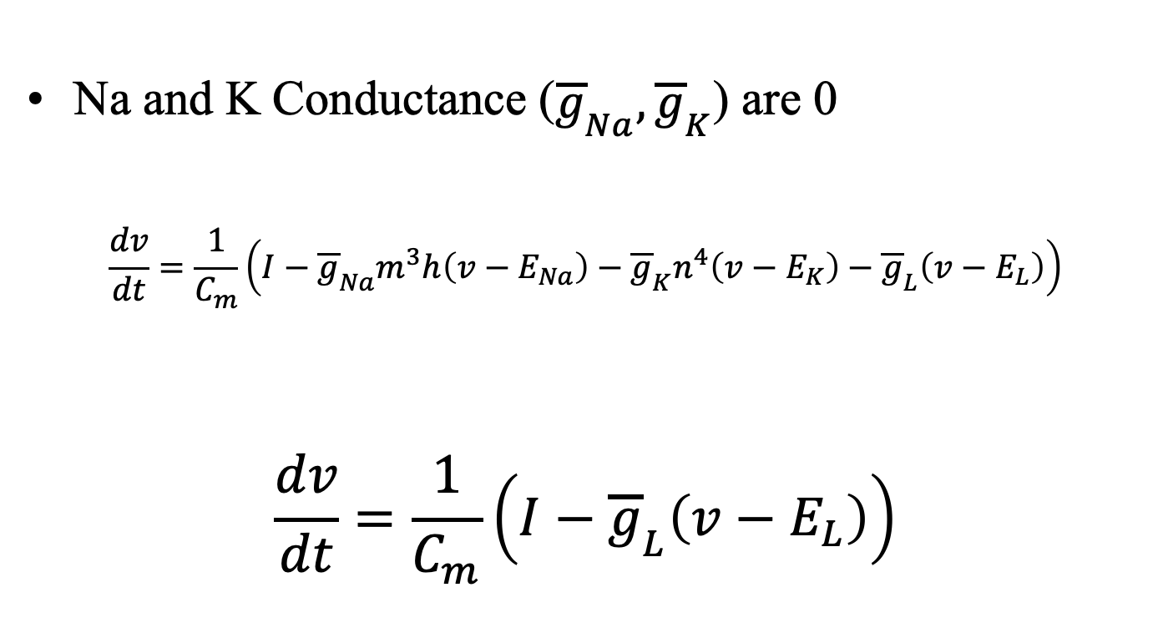
Simplified Model
Na and K Conductance (${\overline{g}}_{Na}, {\overline{g}}_{K}$) are 0
$$\frac{dv}{dt}=\frac{1}{C_{m}}\left(I−{\overline{g}}_{Na}m^{3}h\left(v−E_{Na}\right)−{\overline{g}}_{K}n^{4}\left(v−E_{K}\right)−{\overline{g}}_{L}\left(v−E_{L}\right)\right)$$
$$\frac{dv}{dt}=\frac{1}{C_{m}}\left(I−{\overline{g}}_{L}\left(v−E_{L}\right)\right)$$

Slide 35
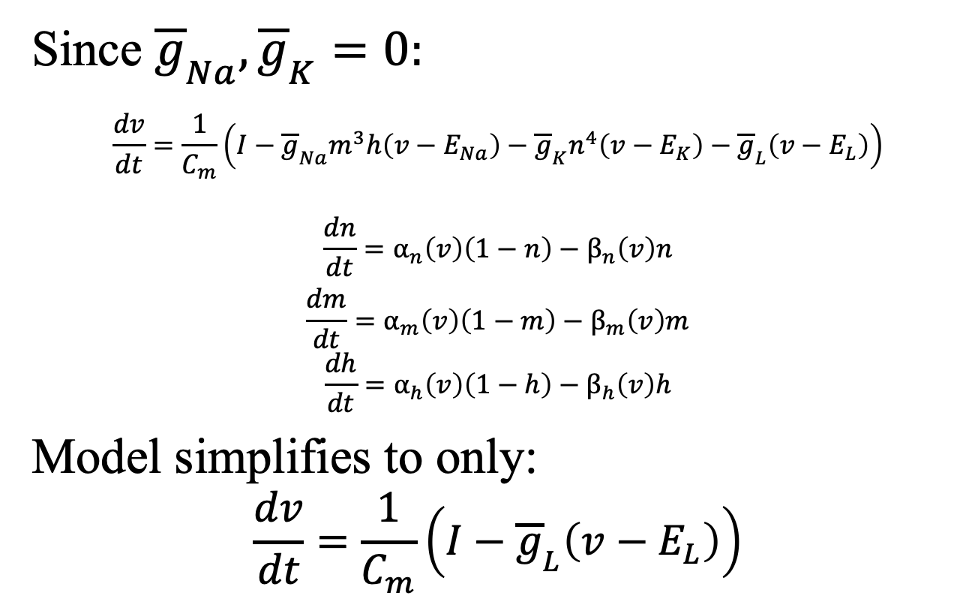
Simplified Model
Since ${\overline{g}}_{Na}, {\overline{g}}_{K}=0:$
$$\frac{dv}{dt}=\frac{1}{C_{m}}\left(I−{\overline{g}}_{Na}m^{3}h\left(v−E_{Na}\right)−{\overline{g}}_{K}n^{4}\left(v−E_{K}\right)−{\overline{g}}_{L}\left(v−E_{L}\right)\right)$$
$$\frac{dn}{dt}=α_{n}\left(v\right)\left(1−n\right)−β_{n}\left(v\right)n$$
$$\frac{dm}{dt}=α_{m}\left(v\right)\left(1−m\right)−β_{m}\left(v\right)m$$
$$\frac{dh}{dt}=α_{h}\left(v\right)\left(1−h\right)−β_{h}\left(v\right)h$$
Model simplifies to only:
$$\frac{dv}{dt}=\frac{1}{C_{m}}\left(I−{\overline{g}}_{L}\left(v−E_{L}\right)\right)$$
0
0
0 supporting functions
4 constants

Slide 36
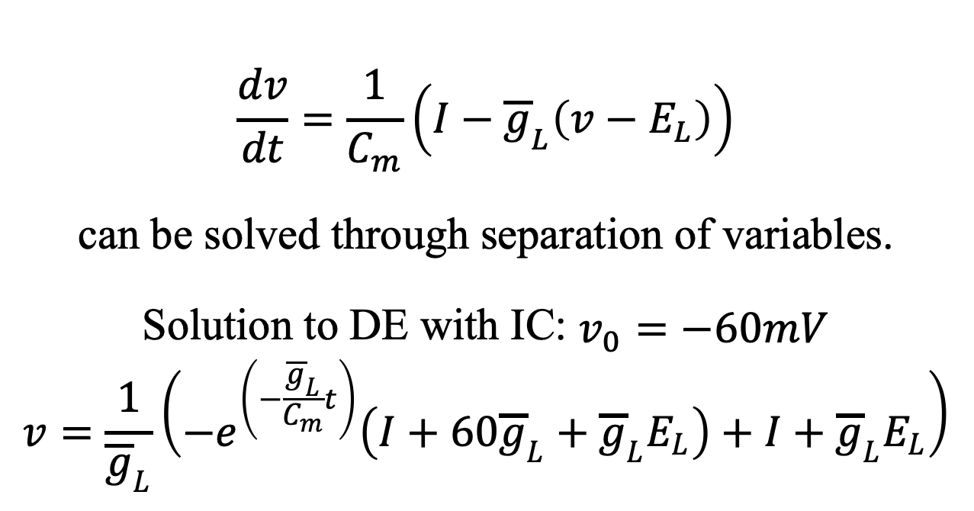
Exact Solution
$$\frac{dv}{dt}=\frac{1}{C_{m}}\left(I−{\overline{g}}_{L}\left(v−E_{L}\right)\right)$$
can be solved through separation of variables.
Solution to DE with IC: $v_{0}=−60mV$
$$v=\frac{1}{{\overline{g}}_{L}}\left(−e^{\left(−\frac{{\overline{g}}_{L}}{C_{m}}t\right)}\left(I+60{\overline{g}}_{L}+{\overline{g}}_{L}E_{L}\right)+I+{\overline{g}}_{L}E_{L}\right)$$
$I=0.1 \frac{μF}{cm^{2}}, C_{m}=0.01\frac{μF}{cm^{2}}$, ${\overline{g}}_{L}=0.003\frac{mS}{cm^{2}}$, $E_{L}=−49.42mV$

Slide 37
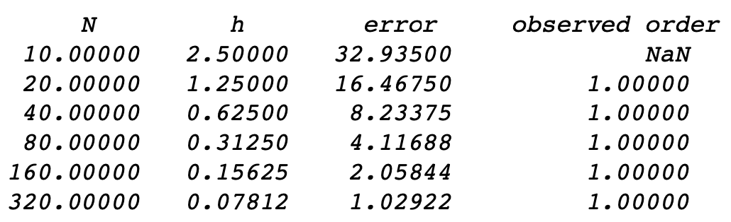
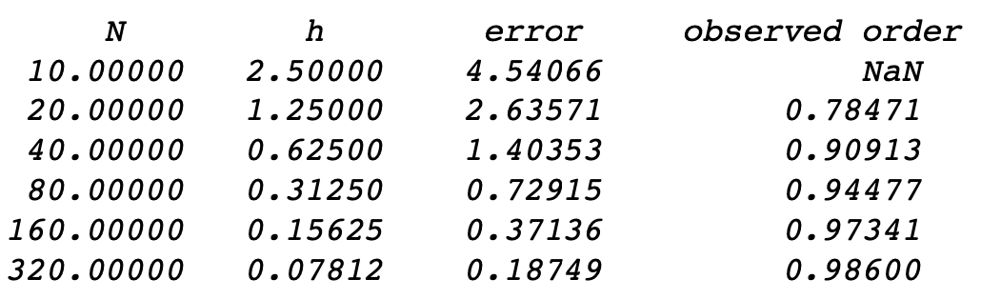
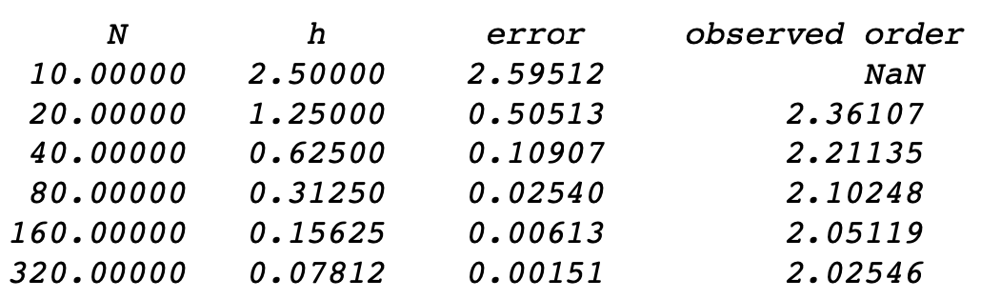
Euler’s Methods
Forward Euler
1st Order Method
Backward Euler
1st Order Method
Modified Euler
2nd Order Method

Slide 38
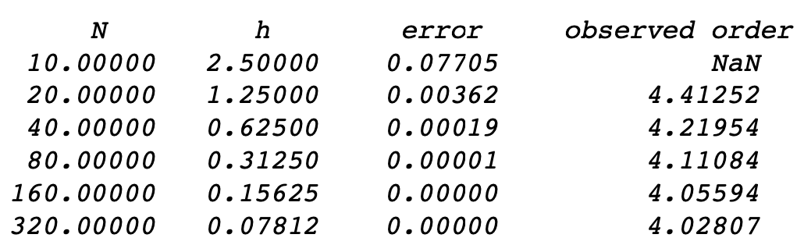
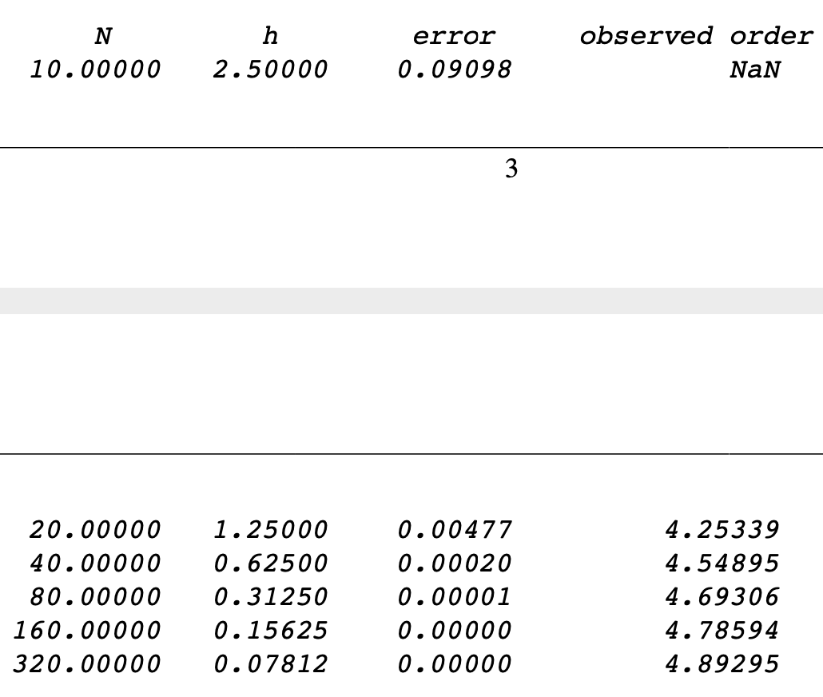
RK4 and ABMPC4 Methods
RK4
4th Order Method
ABMPC4
4th Order Method

Slide 39
Average Error and Order
Method | Paper’s Average Error | Average Error | Average Order
Forward Euler | 0.034984 | 10.80680 | 1
Backward Euler | - | 1.64465 | 0.91960
Modified Euler | - | 0.54039 | 2.15031
RK4 | 1.0155e-7 | 0.01348 | 4.16538
ABMPC4 | 1.2004e-8 | 0.01599 | 4.63486
ODE45 | 3.0036e-4 | 0.00589 | 0.05527

Slide 40
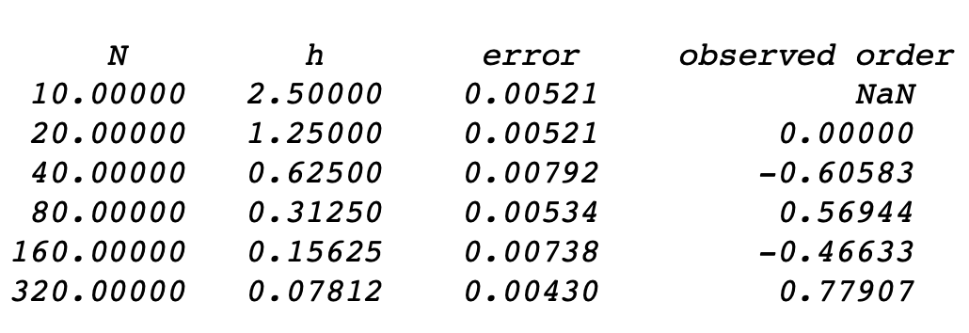
Coding Difficulties
Numerical Analysis and Exact Solution not coded
Calculation to find average error and order not implemented
Forward and Backward Euler Methods were not analyzed in original paper
ODE45

Slide 41
Conclusions
Hodgkin-Huxley Model is important to understanding action potentials
Simplifying the model made numerical analysis possible
Numerical Methods ranked worst to best at approximating the solution:
Forward Euler
Backward Euler
Modified Euler
RK4
ABMPC4
ODE45

Slide 42
References
Siciliano, R. (2012, June 3). The Hodgkin-Huxley Model: Its Extensions, Analysis and Numerics.
Predictor–corrector method. (2020, May 10). Retrieved from https://en.wikipedia.org/wiki/Predictor–corrector_method
Odefun. (n.d.). Retrieved from https://www.mathworks.com/help/matlab/ref/ode45.html
Hodgkin–Huxley model. (2020, November 16). Retrieved from https://en.wikipedia.org/wiki/Hodgkin–Huxley_model
Sauer, T. (2012). Numerical Analysis. Boston: Pearson Education.
Squid giant axon. (2020, August 30). Retrieved from https://en.wikipedia.org/wiki/Squid_giant_axon
LeVeque, R. J. (2007, April 25). Error_table.m. Retrieved from http://faculty.washington.edu/rjl/fdmbook/matlab/error_table.m
Thank you, Professor Gottlieb, for providing the base code necessary for most of the numerical analysis!

